Slide 2
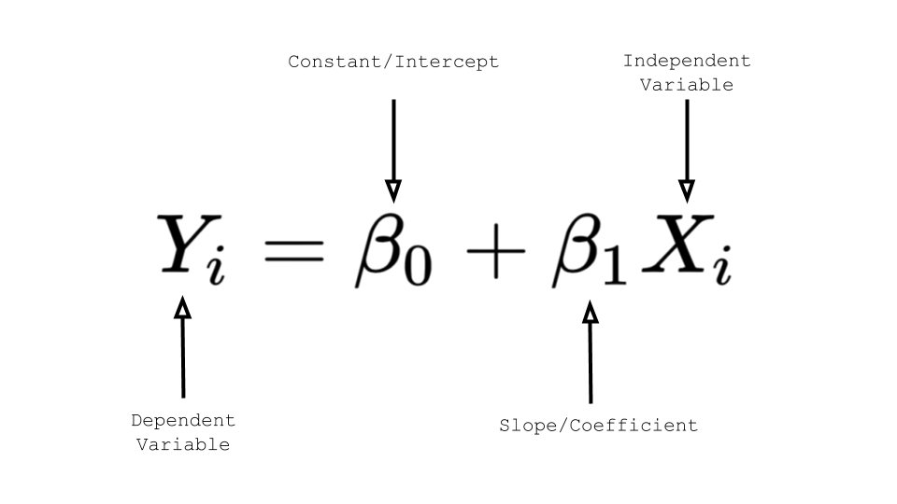
Linear Regression Formula

